Slide 1
CSS Grid
By Ehtisham amjad

Slide 2
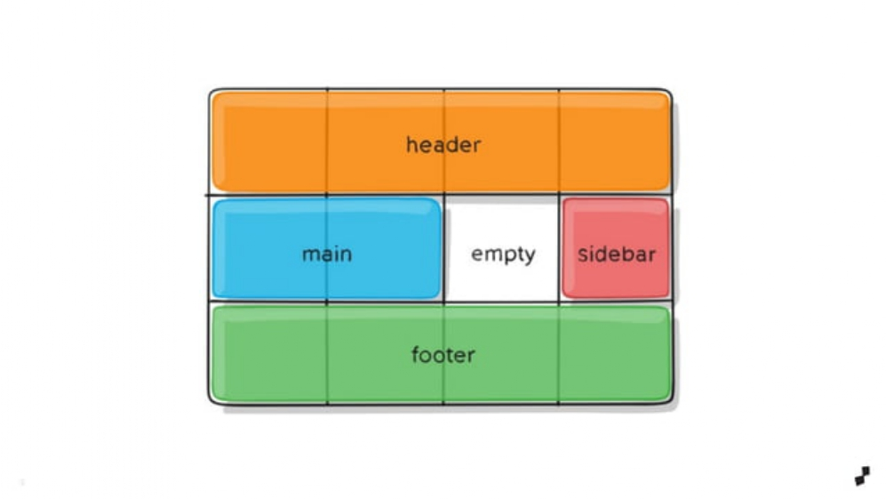
What is CSS grid
Css Grid is a 2 dimensional layout system that can handle both columns and row.

Slide 3
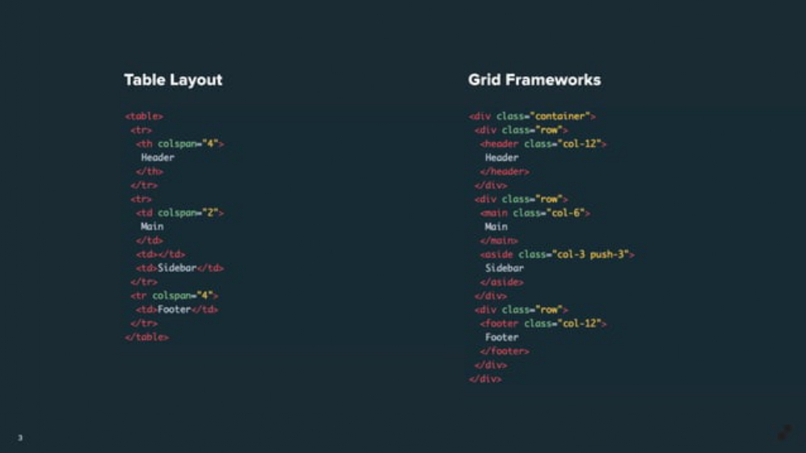

Slide 4
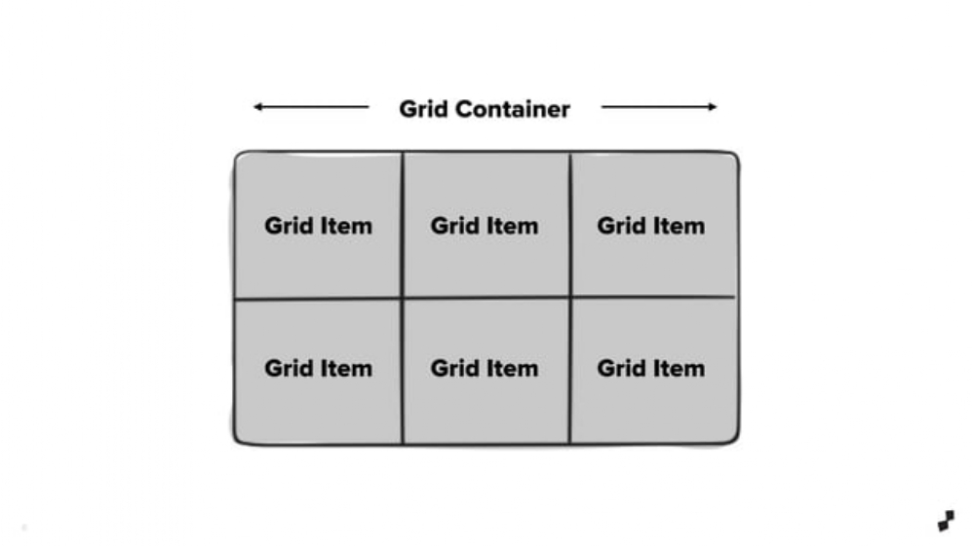

Slide 5


Slide 6
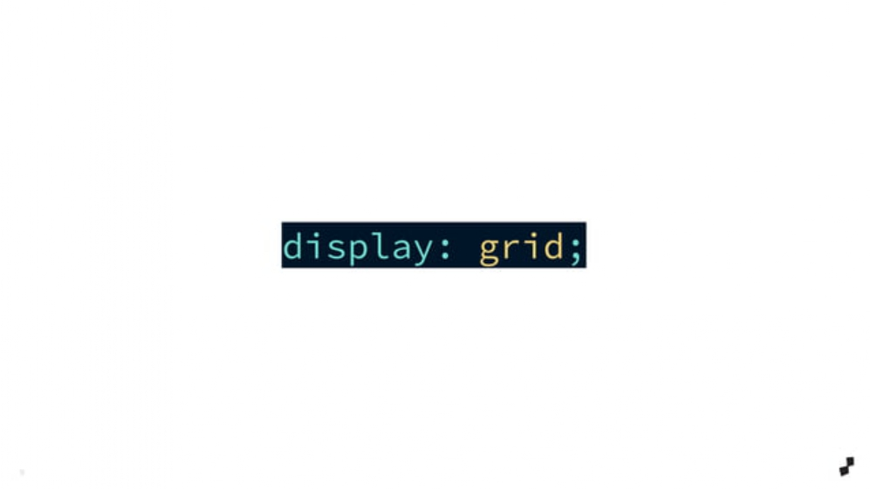

Slide 7
Grid Container
.grid-container { display: grid; grid-template-columns: auto auto auto auto; }

Slide 8
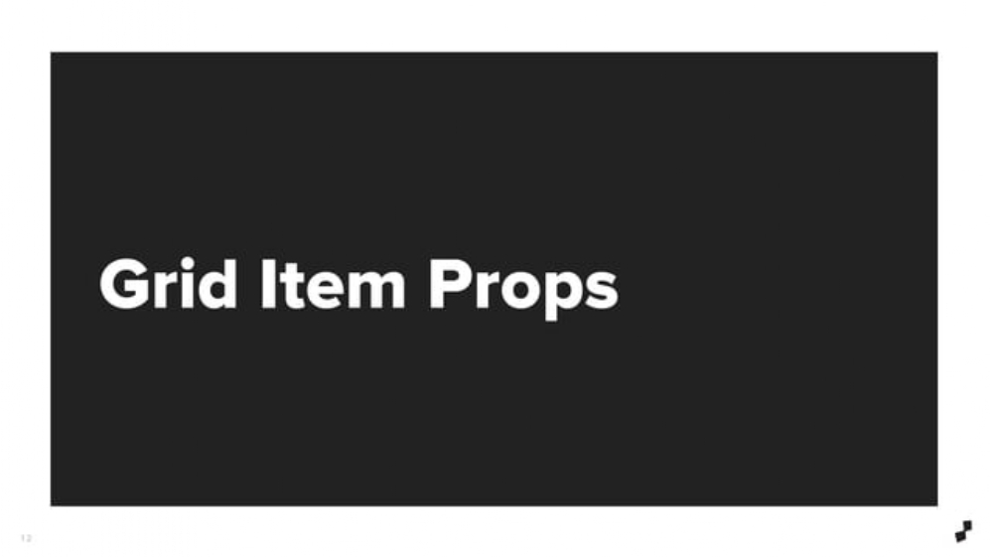

Slide 9
ITEM Container
.item1 { grid-row: 1 / span 2; }

